Slide 1
"Airline Travel"
"Analyzing Customer Satisfaction and Service Quality in Airline Travel“
BY MOHIT KUMAR

Slide 2
Key Columns: Gender, Customer Type, Type of Travel, Class, and satisfaction are categorical, useful for demographic and categorical analysis.

Slide 3
The numeric columns include service ratings: (e.g., Inflight wifi service, Seat comfort), Age, Flight Distance, Departure Delay in Minutes, and Arrival Delay in Minutes.

Slide 4
Categorical Analysis: satisfaction has two categories: "satisfied" and "neutral or dissatisfied," which can be analyzed to understand satisfaction trends across other factors.

Slide 5
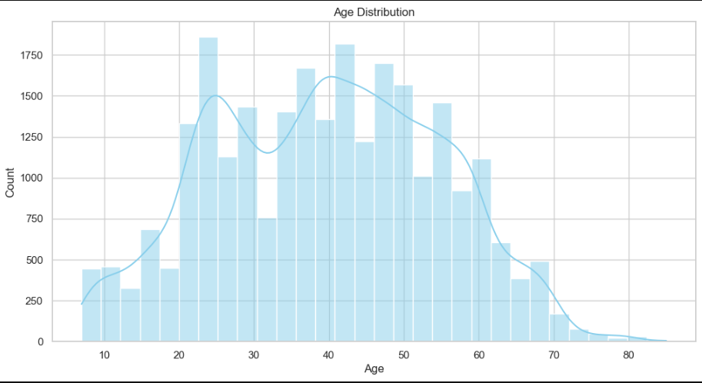
Age Distribution: The age distribution shows the spread of customer ages. This can help identify if certain age groups are more common in the dataset.

Slide 6
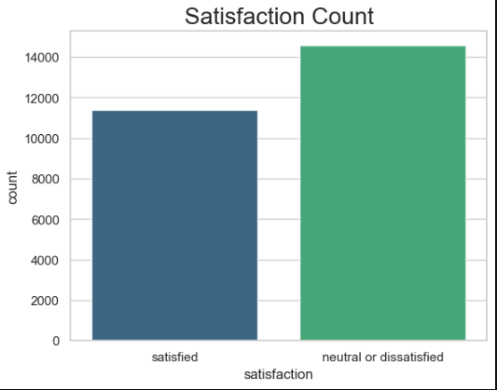
Satisfaction Count: This count plot shows the distribution of customers between "satisfied" and "neutral or dissatisfied" categories. It provides a quick overview of overall customer satisfaction.

Slide 7
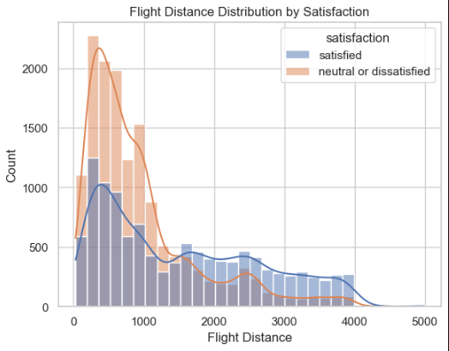
Flight Distance Distribution by Satisfaction: This plot compares the flight distance distributions for satisfied and neutral/dissatisfied customers. We can observe if there is a difference in flight distance preferences among satisfied customers.

Slide 8
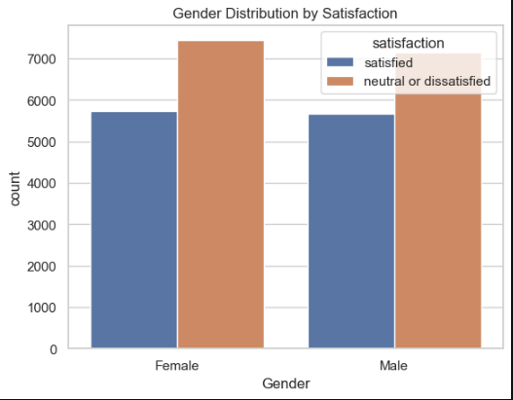
Gender Distribution by Satisfaction: This plot shows the distribution of satisfaction levels across genders, allowing us to see if there's a noticeable difference in satisfaction based on gender.

Slide 9
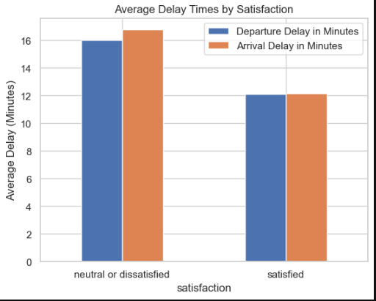
Average Delay Times by Satisfaction: This bar plot compares the average Departure Delay and Arrival Delay for satisfied vs. neutral/dissatisfied customers, giving insight into whether delays affect customer satisfaction.

Slide 10
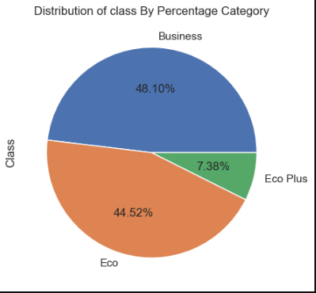
Distribution of class By Percentage Category

Slide 11
**Conclusion**: Customer satisfaction is largely influenced by service quality and delays. Key factors like seat comfort, inflight entertainment, and punctuality play crucial roles, suggesting that improvements in these areas could boost overall satisfaction and loyalty.

Slide 12
THANK YOU

